Slide 1
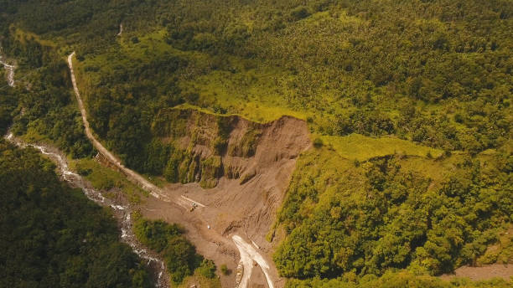
Landslide Mapping Using geospatial Workflow Technologies
Presented By:
Lt Col Ishan Sharma
Maj Suraj Choubey
Ishan Goyal
Nikita Supekar
.

Slide 2
Preview
Introduction
Objectives
Future Scope
Limitation
Methodology

Slide 3
Introduction
Brief
Existing Uttarakhand disaster management portal contains statistical information Related To Landslide.
Requires Augmenting With Photographic Evidence in Real Time.
Work will Enhance Understanding and Better Assimilation of Severity and Collateral Damage Caused by landslides.
Scope
Central Platform with Dashboard Utility.
Utilization of Crowd Sourcing Data in Real Time.
Data Sources
Real Time Geotagged Photographs.
Social Media Handles (Facebook/ Twitter/ Instagram).
Enhance Coordination Among Different Stakeholders and Government Agencies.

Slide 4
Objectives

Slide 5
Objectives
To Create Dashboard For Users to Post Real Time Photographs
To Create a Central Database Which Act as Repositary
To Augument the Database by Utilising Information Extracted from Social Media Platforms.
To Provide Visualization of on Dashboard

Slide 6
Methodology

Slide 7
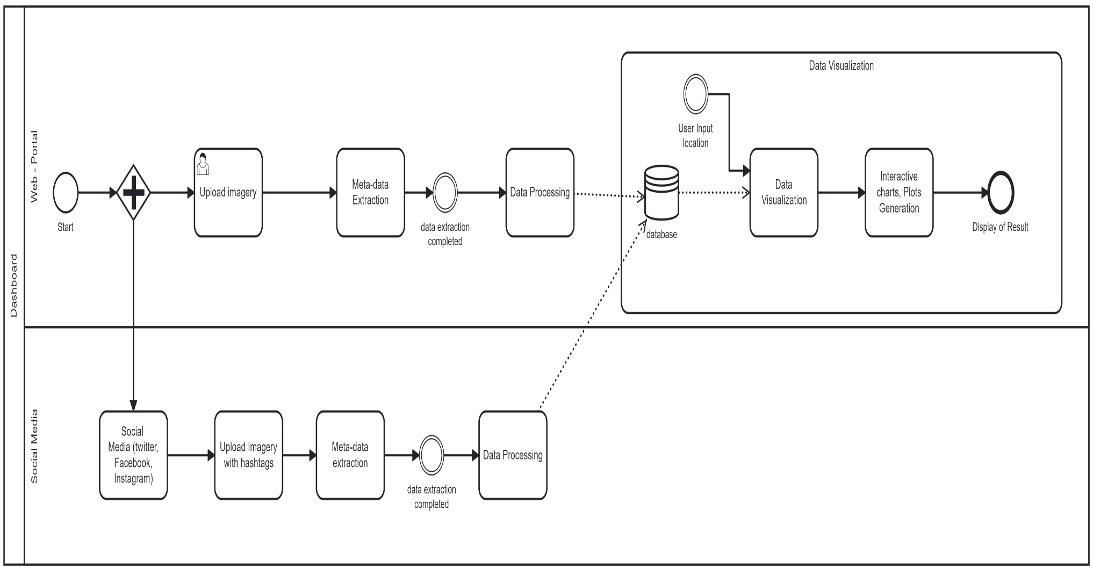
Bpmn Diagram

Slide 8
Dashboard Utility

Slide 9
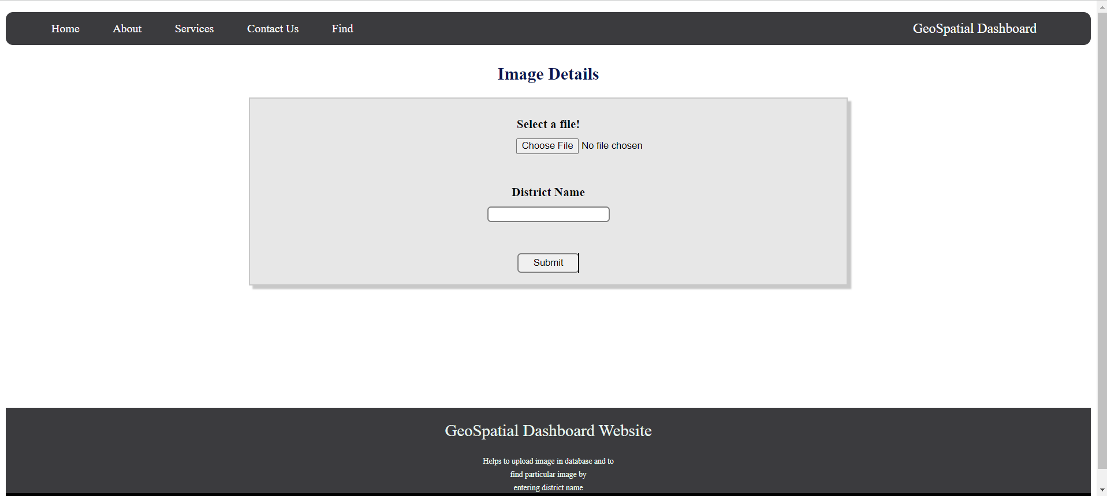

Dashboard Utility
Input for geo-tagged imagery from user
Choose button to select
imagery to be uploaded from local
system or camera directly.
Field to input location
of the
uploaded imagery
Submit button for submission of
request for imagery upload to data base.

Slide 10
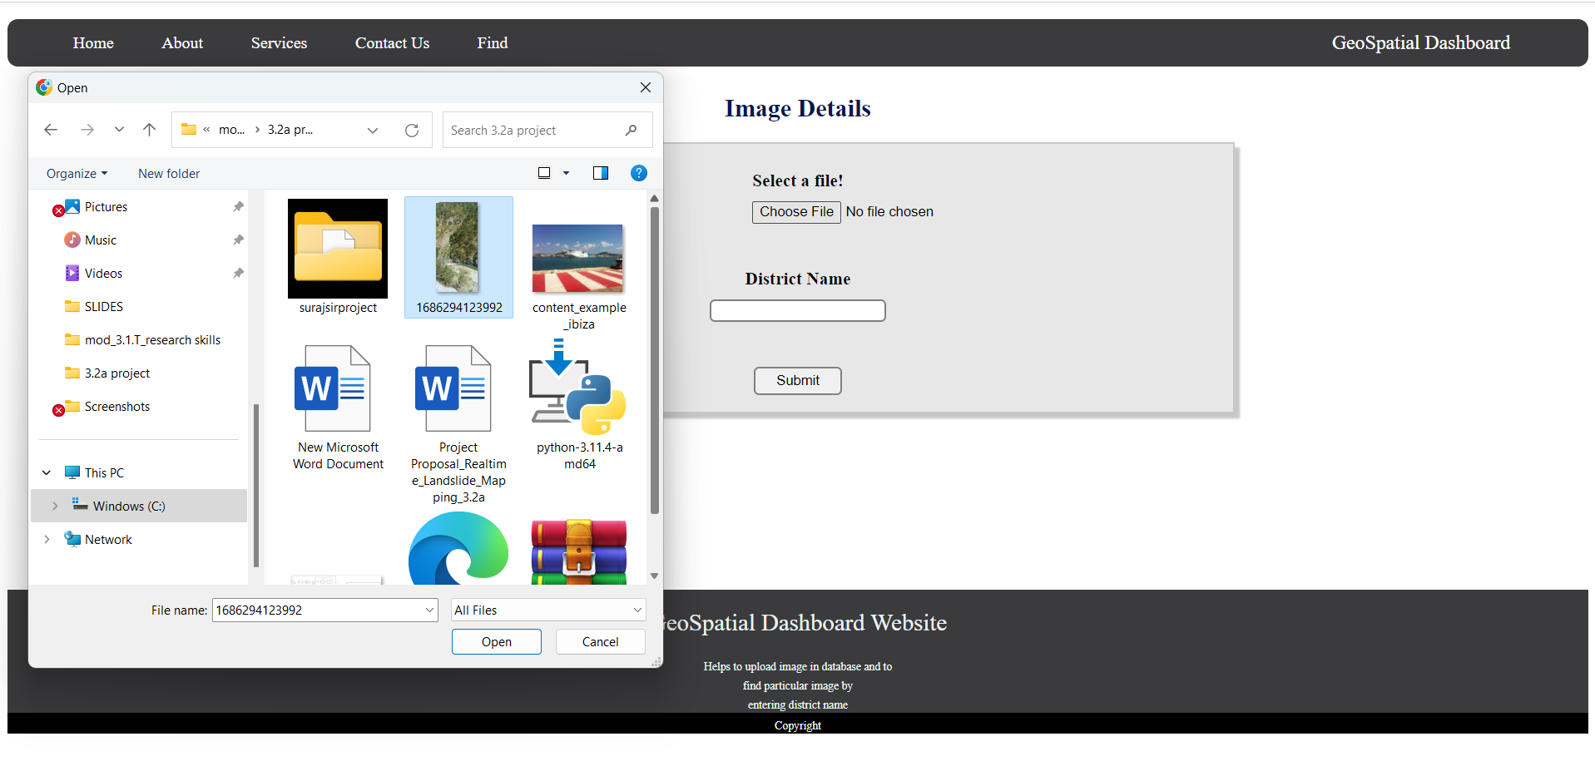
Dashboard Utility
Selecting image without
geolocation.

Slide 11
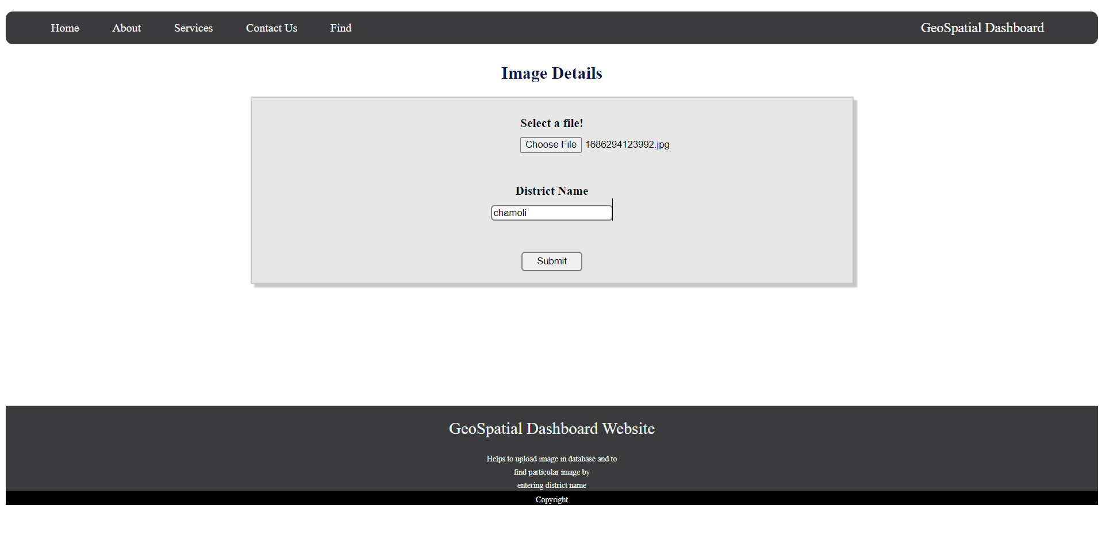
Dashboard Utility

Slide 12
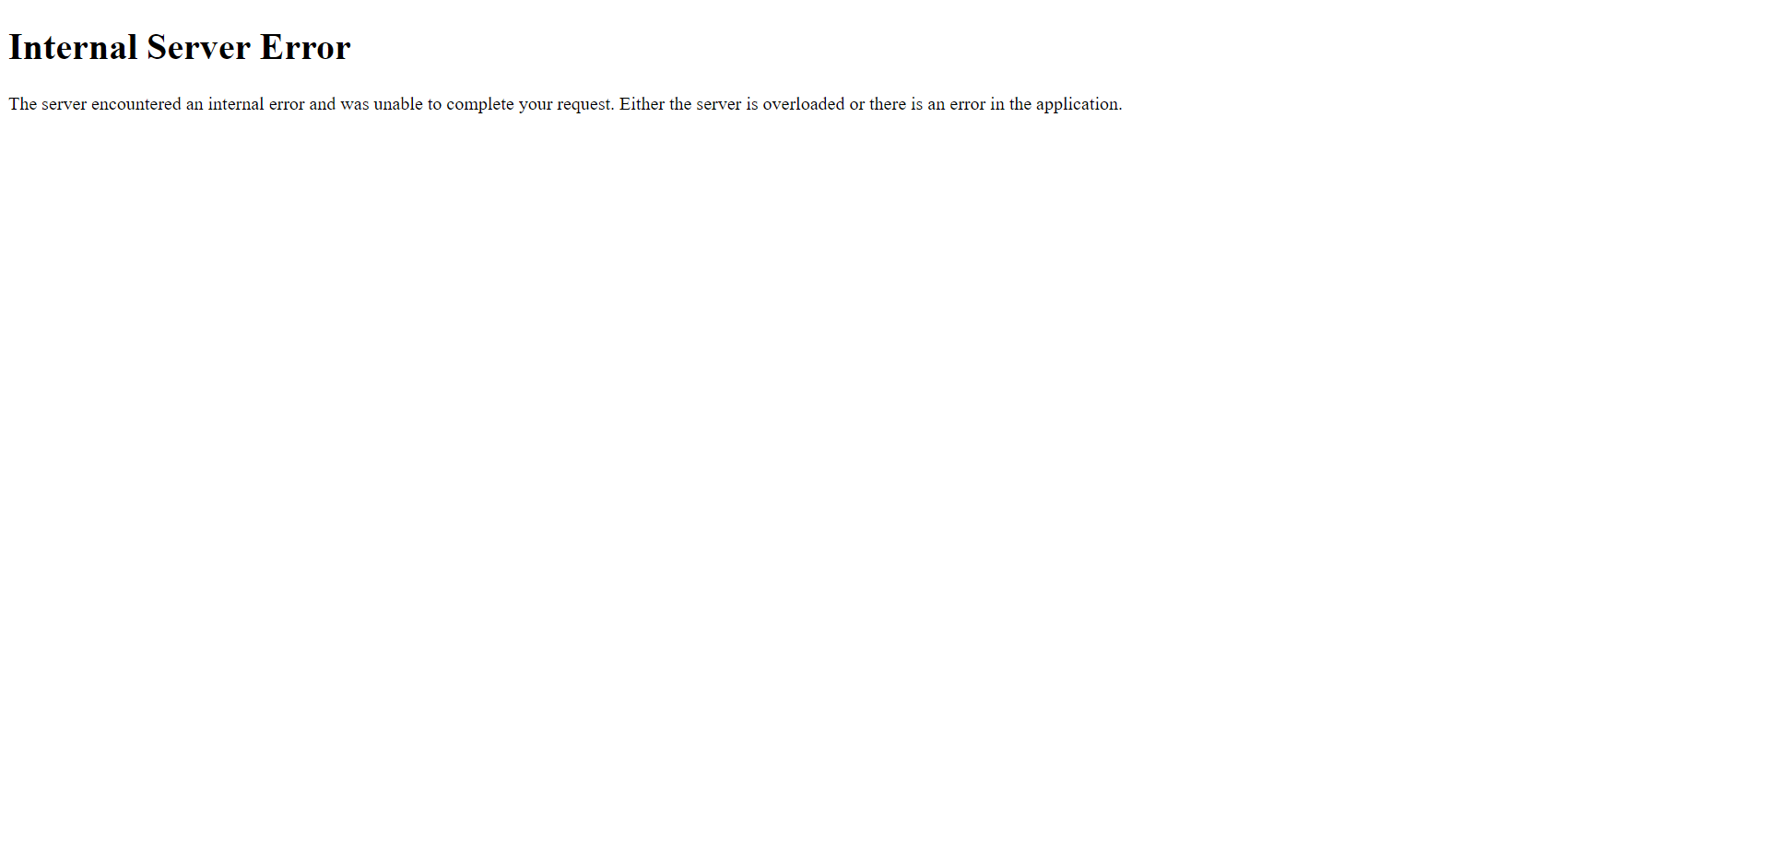
Dashboard Utility
Error is displayed when the
uploaded imagery
lacks geolocation.

Slide 13
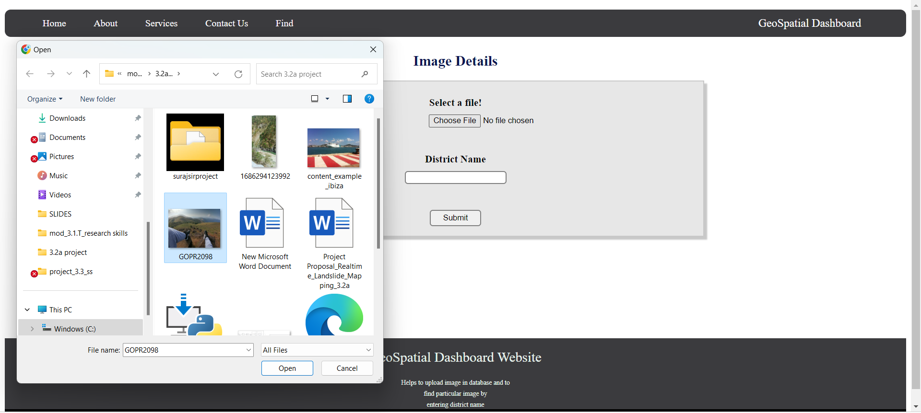
Dashboard Utility
Selecting image with
geolocation data.

Slide 14
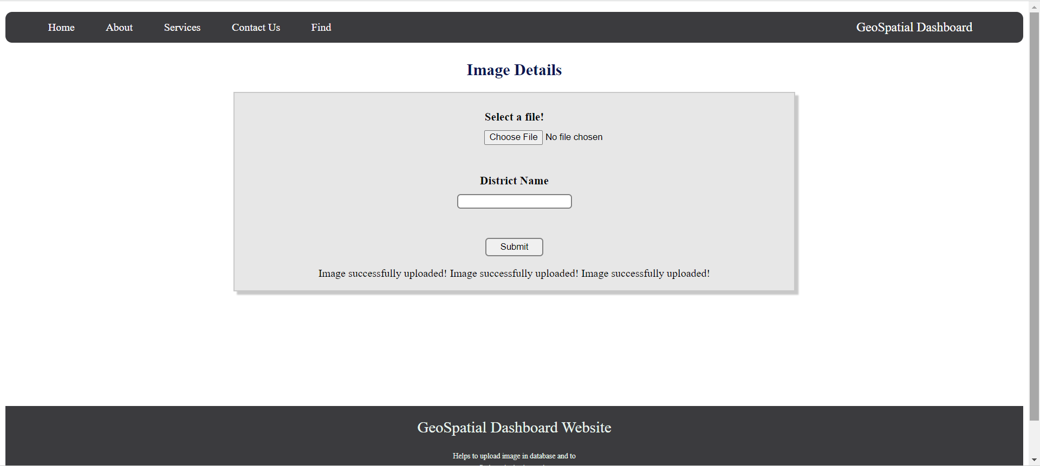
Dashboard Utility

Slide 15
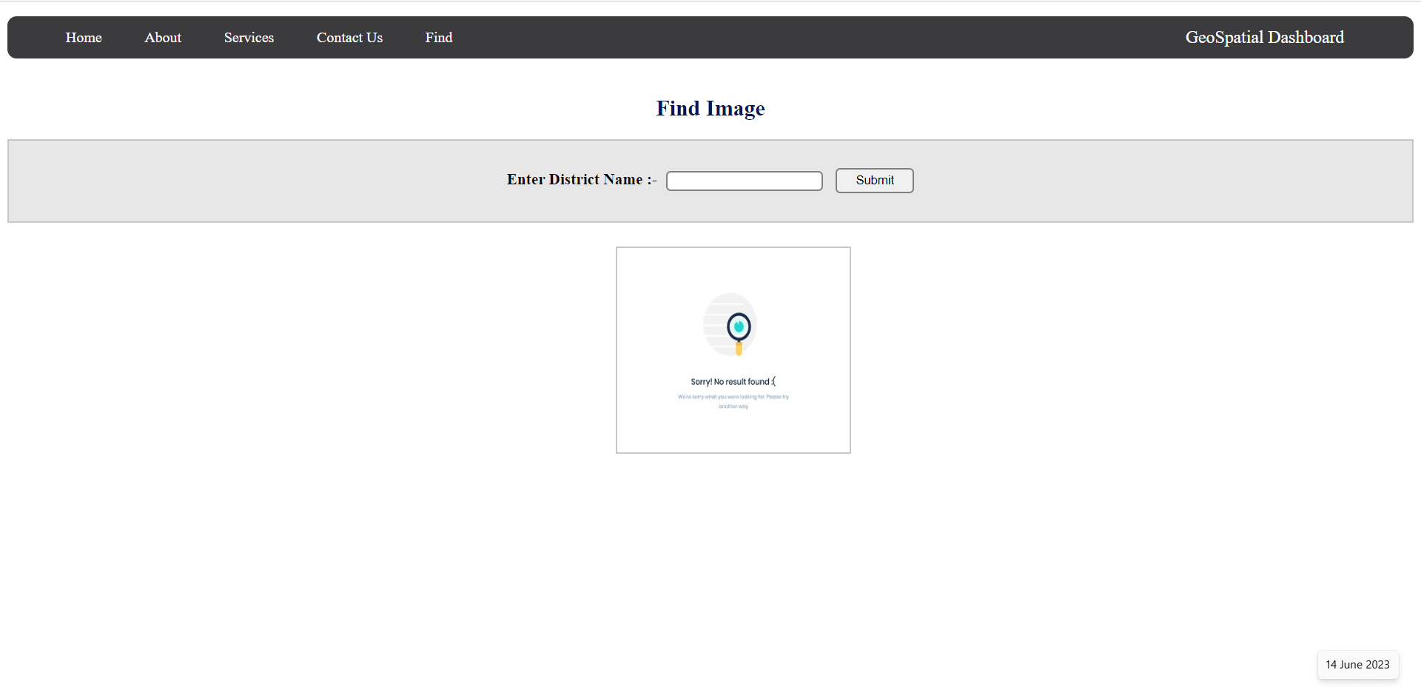
Dashboard Utility
Find button in toolbar to
search imagery from the database.
Field to input District name
to search imagery from database.
Submit button for submission of
request for imagery retrieval from database.
Area to display imagery retrieved
from database.

Slide 16
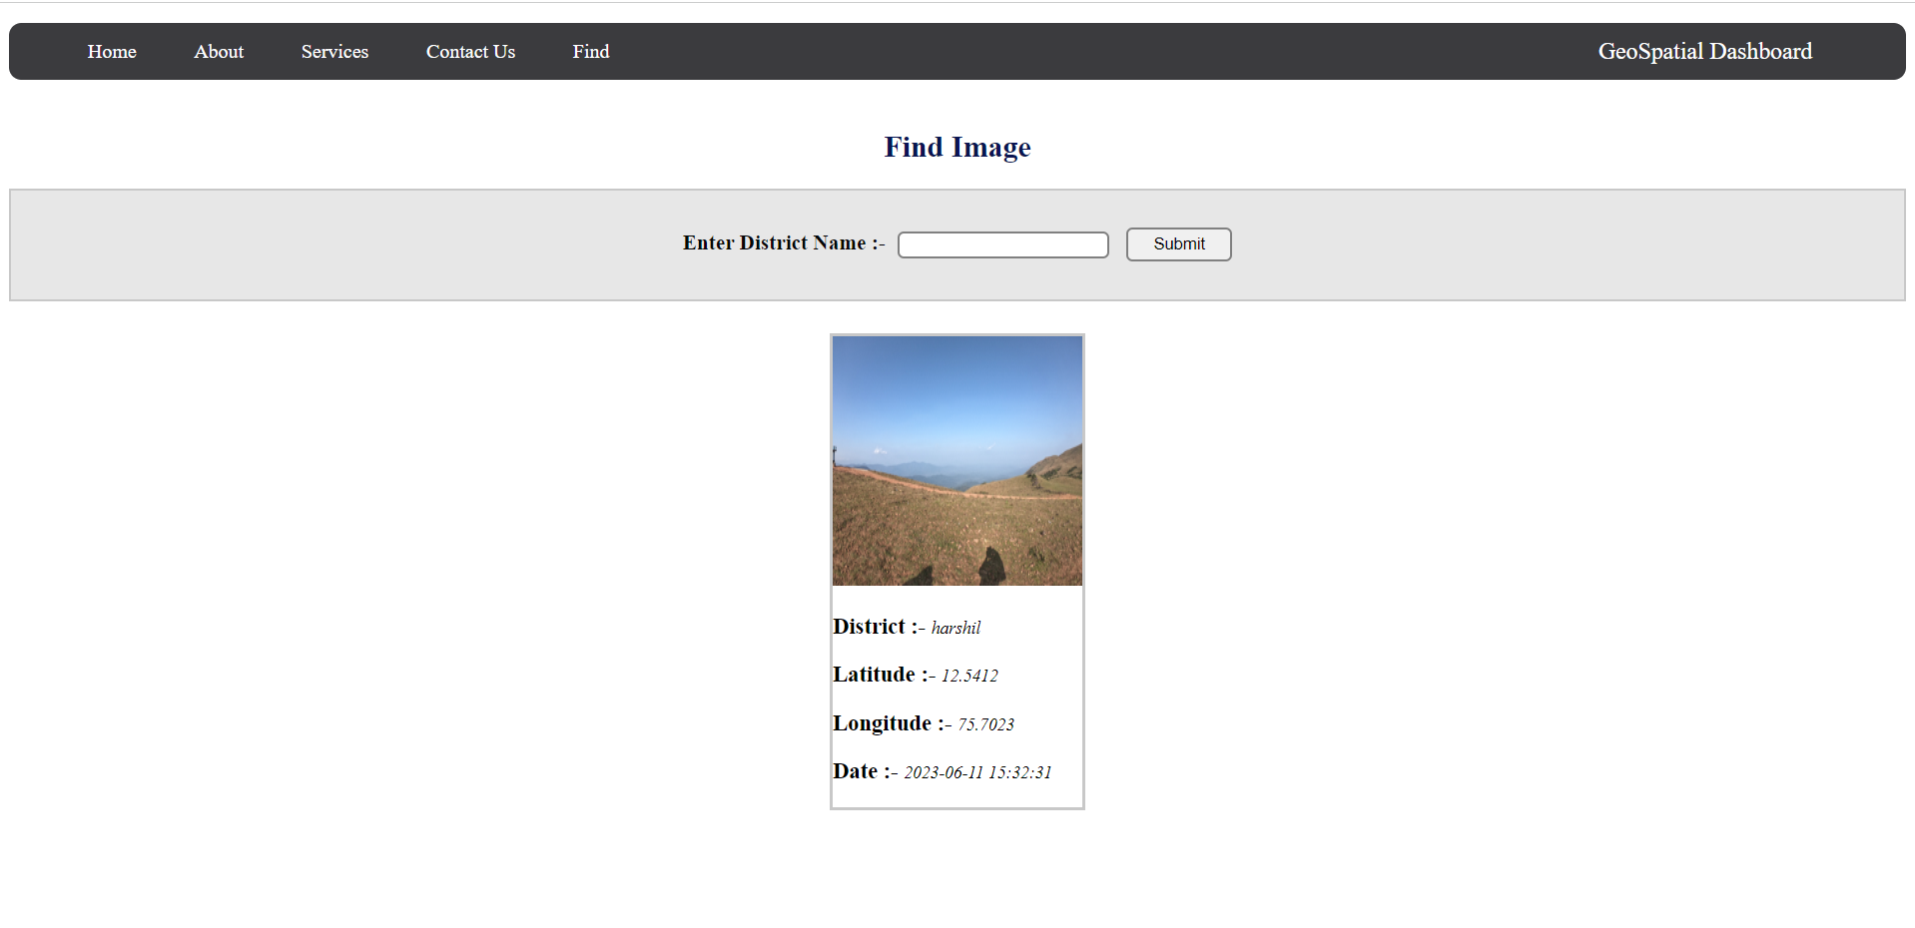
Dashboard Utility
Display of imagery requested
from the database.

Slide 17
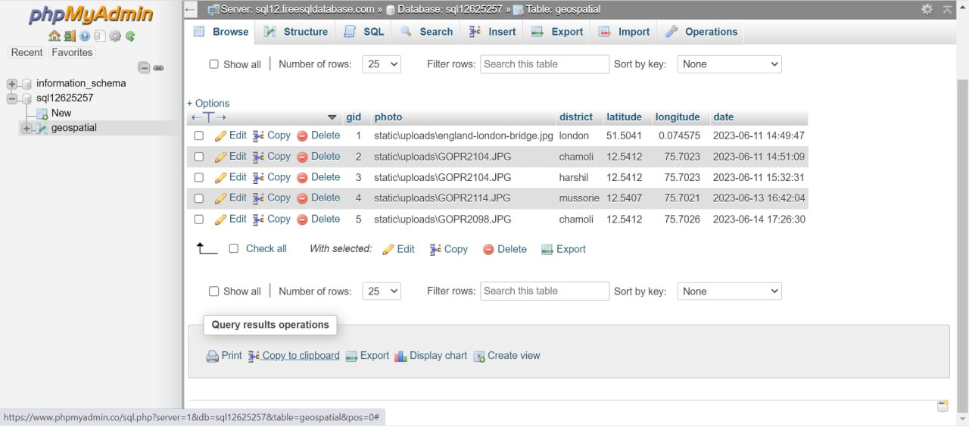
Dashboard Utility
SQL database generated after
imagery upload by the user.

Slide 18
Social Media Platform

Slide 19
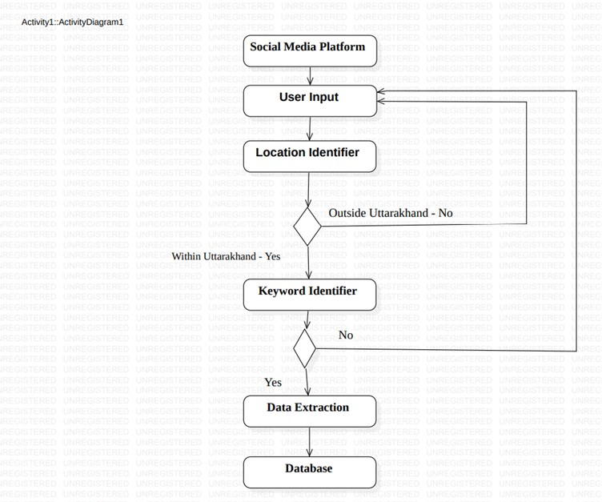
UML Activity Diagram Description

Slide 20
Limitations

Slide 21
Limitations
Authenticity Of Crowd Sourcing Data
Interoperability Issues Due to Hetrogeneous Nature of data Source.
Dedicated Database with Improved Funtionalities.

Slide 22
Future Scope

Slide 23
Future Scope
Semantic Enrichment of Geospatial Information Using Current State Of Art (Artificial Intelligence ).
Further Extension for Creating Database Related to Various Natural Disasters For Entire Country.
Inclusion of Machine Learning Techniques for Data Extraction.

Slide 24

Questions
Thank You

